Slide 1

COLORECTAL CANCER SCREENING
Scenarios for National Colorectal Cancer Screening Network (NCCSN)
May 15 2014

Slide 2
Acknowledgements
Andy Coldman
Anthony Miller
Claude Nadeau
Norm Phillips
Saima Memon
William Flanagan

Slide 3
Background
Feedback received from Network members:
  More on FIT vs. gFOBT
  FIT cut-off thresholds
  Error bands
  Breakdown of males/females
  Jurisdictional analysis
Report to be disseminated to Network in June

Slide 4
Assumptions
Input | Baseline assumptions
Recruitment period | 2014 onward
Eligibility | Average risk men & women, 50-74 years old
Participation | 30% & 60%
Phase-in period | Ten year phase-in for cohorts entering in 2014 No phase-in for cohorts entering 2015 onwards
Compliance | FIT/gFOBT: 93% Flex sig & colonoscopy : 80%
Screening modalities | FIT, gFOBT, flex sig, colonoscopy, combination
*FIT = fecal immunochemical test; gFOBT = guaiac fecal occult blood test; flex sig = flexible sigmoidoscopy

Slide 5
Scenarios
Reference | 30% participation | 60% participation
Base Case (no screening) | - | -
Annual FIT | ✓ | ✓
Biennial FIT | ✓ | ✓
Biennial gFOBT | ✓ | ✓
Flex Sig only every 5 years | ✓ | ✓
Biennial FIT 50-59: flex sig at 60: FIT 65-74 | ✓ | ✓
Colonoscopy every 10 years | ✓ | ✓
30% FIT (organised) & 30% colonoscopy (opportunistic) |  | ✓
48% FIT (average/low-risk,organised) &12% colonoscopy (high-risk/organised) |  | ✓

Slide 6
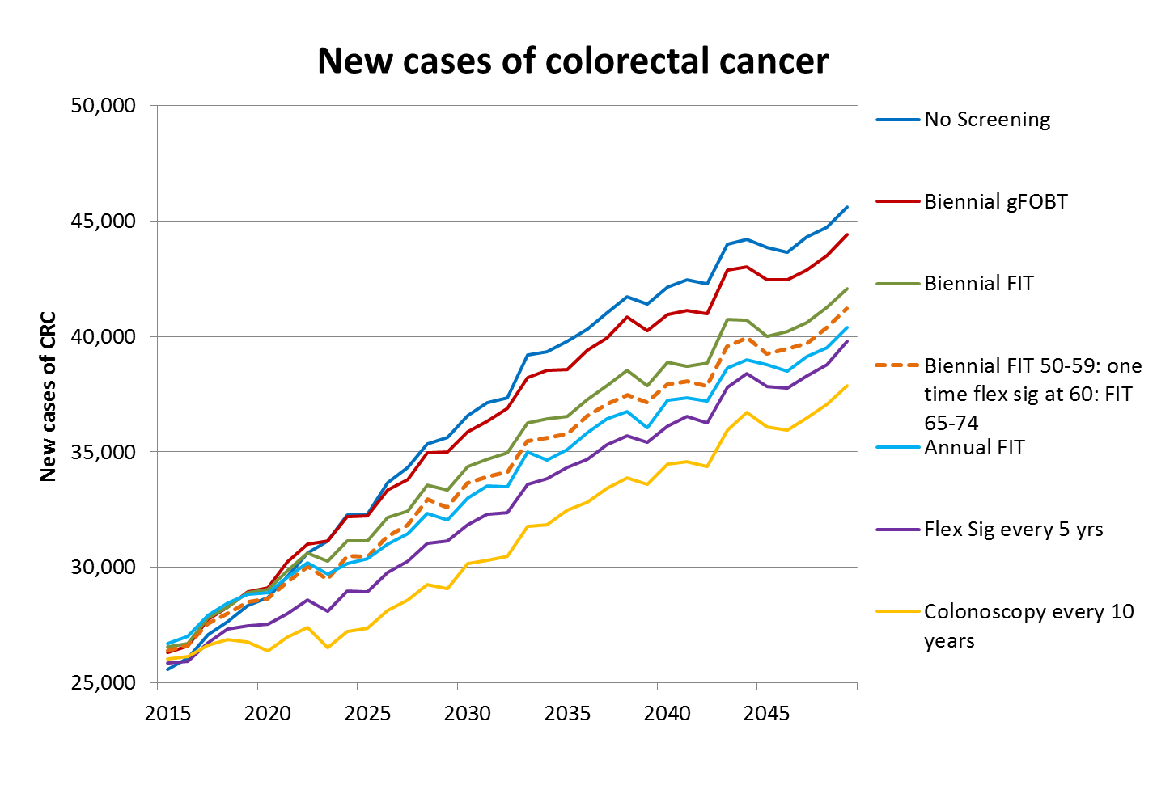
?
*30% participation; non-age standardized; CRC: colorectal cancer; gFOBT; guaiac Fecal Occult Blood Test; FIT: fecal
immunochemical test; Flex Sig: flexible Sigmoidoscopy

Slide 7
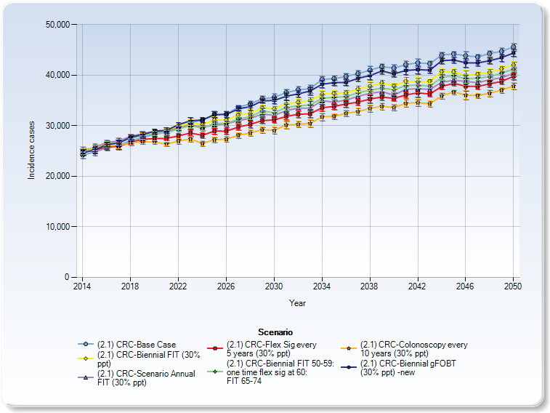
CRC Incidence
not helpful...

Slide 8
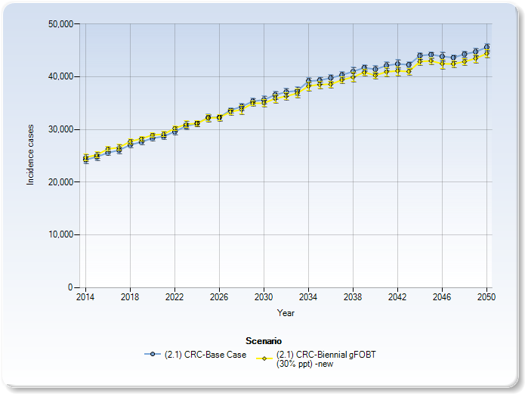
CRC Incidence
No screening compared to gFOBT

Slide 9
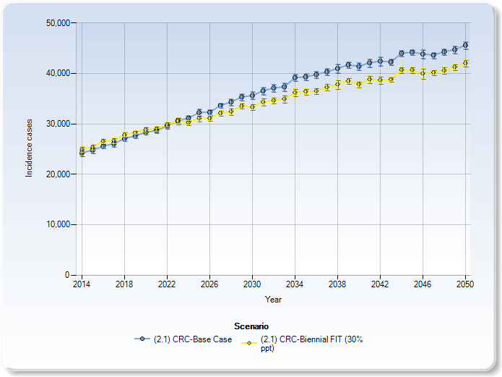
CRC Incidence
No screening compared to FIT

Slide 10
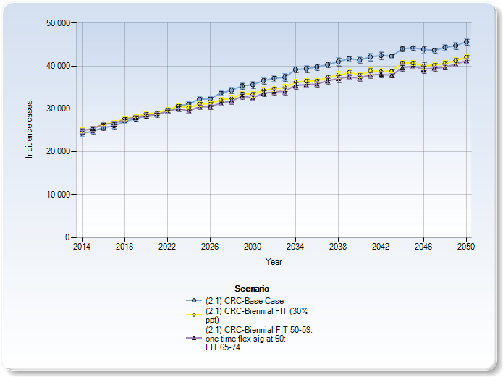
CRC Incidence
FIT compared to FIT + one-time flex sig

Slide 11
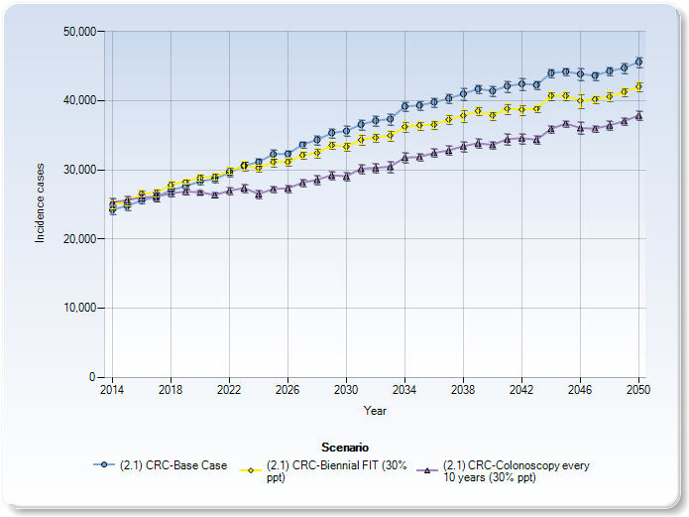
CRC Incidence
No screening compared to FIT and colonoscopy

Slide 12
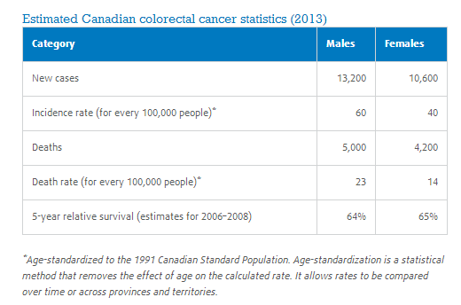

Slide 13
Incidence of colorectal cancer per 100,000
*60% participation; non-age standardized; gFOBT; guaiac Fecal Occult Blood Test; FIT: fecal immunochemical test:
Col: Colonoscopy; CRC: Colorectal cancer

Slide 14
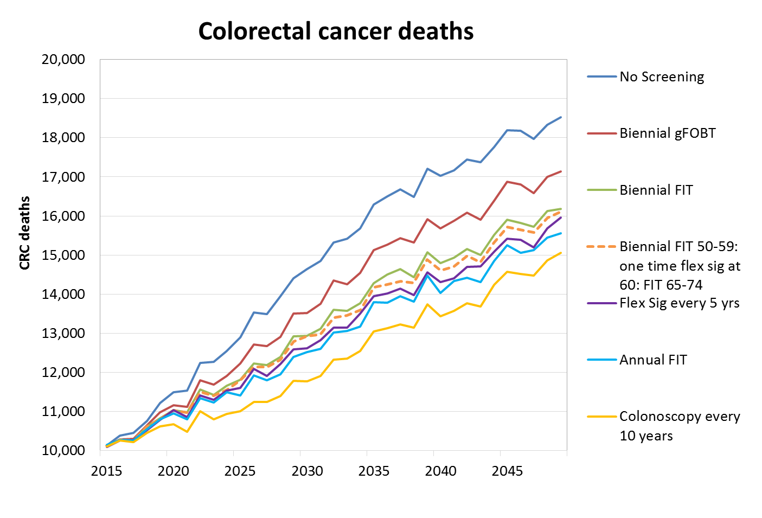
*30% participation; non-age standardized; CRC: colorectal cancer: gFOBT; guaiac Fecal Occult Blood Test; FIT: fecal
immunochemical test; Flex Sig: flexible Sigmoidoscopy

Slide 15
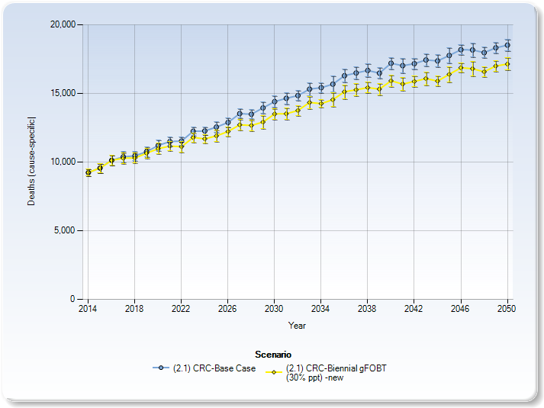
CRC Deaths
No screening compared to gFOBT

Slide 16
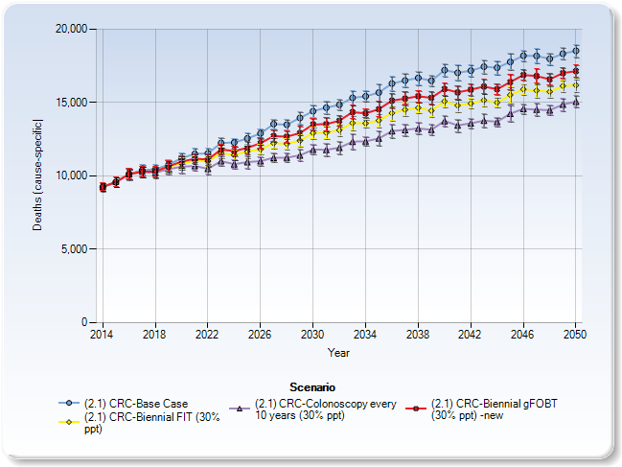
CRC Deaths
No screening compared to gFOBT, FIT and colonoscopy

Slide 17
*30% participation; non-age standardized; CRC: colorectal cancer; gFOBT; guaiac Fecal Occult Blood Test; FIT: fecal immunochemical
test; Flex Sig: flexible Sigmoidoscopy

Slide 18
Highest treatment, lowest screening
Lowest treatment, highest screening

Slide 19
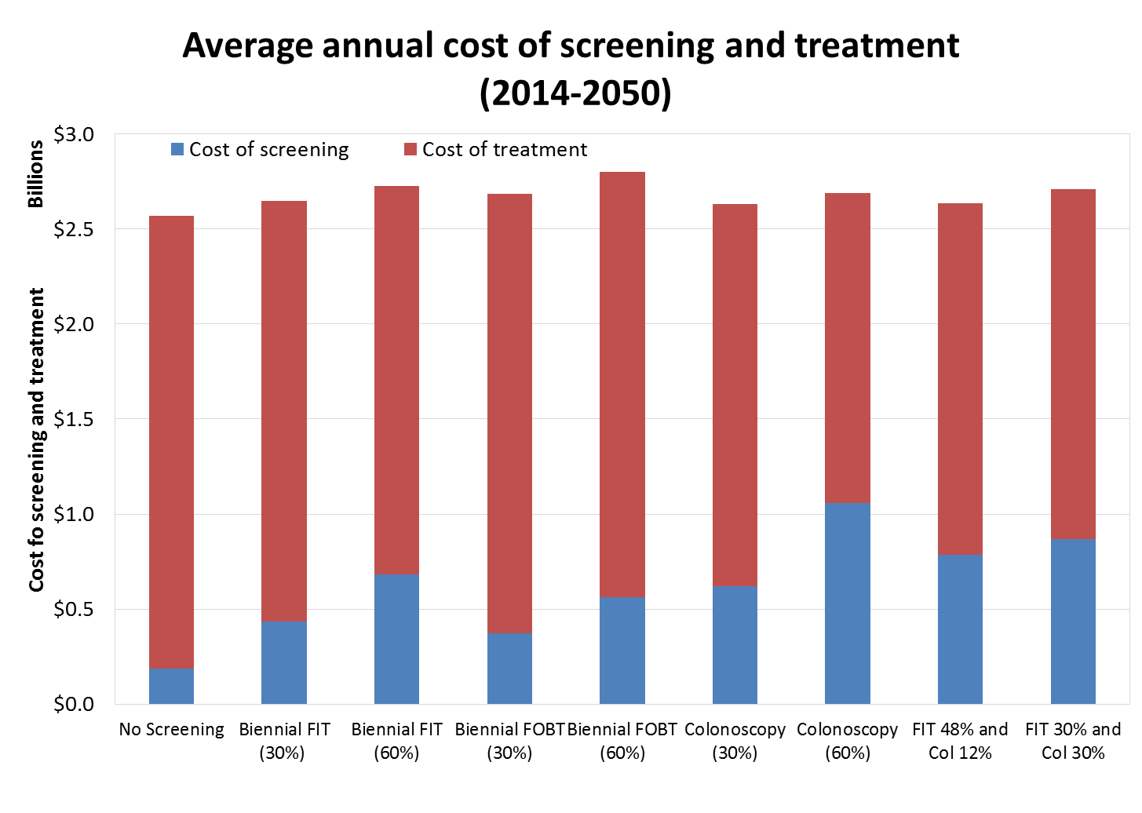
Highest treatment, lowest screening
Lowest treatment, highest screening

Slide 20
* 60% participation; undiscounted costs: gFOBT: guaiac Fecal Occult Blood Test; FIT: fecal immunochemical test

Slide 21
Incremental Cost-Effectiveness Ratios (ICERs)
Costs
reject
(dominated)
consider
(more expensive but
saves more lives)
Lives
consider
(less expensive but
saves fewer lives)
accept
(dominant)

Slide 22
*60% participation; 3% discount; gFOBT: guaiac Fecal Occult Blood Test; FIT: fecal immunochemical test; Col: Colonoscopy

Slide 23
*60% participation; 3% discount; gFOBT: guaiac Fecal Occult Blood Test; FIT: fecal immunochemical test; Col: Colonoscopy

Slide 24
*60% participation; 3% discount; gFOBT: guaiac Fecal Occult Blood Test; FIT: fecal immunochemical test; Col: Colonoscopy

Slide 25
*60% participation; 3% discount; gFOBT: guaiac Fecal Occult Blood Test; FIT: fecal immunochemical test; Col: Colonoscopy

Slide 26
Scenarios | Average annual total costs (undiscounted) | ICER (cost/QALY) (3% discounted)
No Screening | $2.57B | -
Colonoscopy x 10 years | $2.63B - $2.70B | DOMINANT
FIT for low-risk (48%) & colonoscopy for high-risk (12%) | $2.64B | DOMINANT
FIT (30%) and opportunistic colonoscopy (30%) | $2.71B | $770
Biennial FIT | $2.65B - $2.73B | $2,600
Biennial FIT + one-time flex sig at 60 | $2.68B - $2.79B | $3,900
Annual FIT | $2.74B - $2.90B | $6,300
Flex Sig only x 5 years | $2.85B - $3.13B | $13,000
Biennial FOBT | $2.69B - $2.80B | $13,900

Slide 27
FIT cut-off values
Example: FIT 200ng
1. Run Upper/Upper : sensitivity = 80
specificity = 98
2. Run Lower/Lower: sensitivity = 55
specificity = 90
3. Midpoint of those values
 | FIT 200 ng hemoglobin per mL | FIT 150 ng hemoglobin per mL | FIT 100 ng hemoglobin per mL | FIT 75 ng hemoglobin per mL | FIT 50 ng hemoglobin per mL
Sensitivity Upper | 80 | 84 | 88 | 92 | 95
Sensitivity Lower | 55 | 60 | 65 | 70 | 75
Specificity Upper | 98 | 96 | 94 | 92 | 90
Specificity Lower | 90 | 88 | 85 | 82 | 80

Slide 28
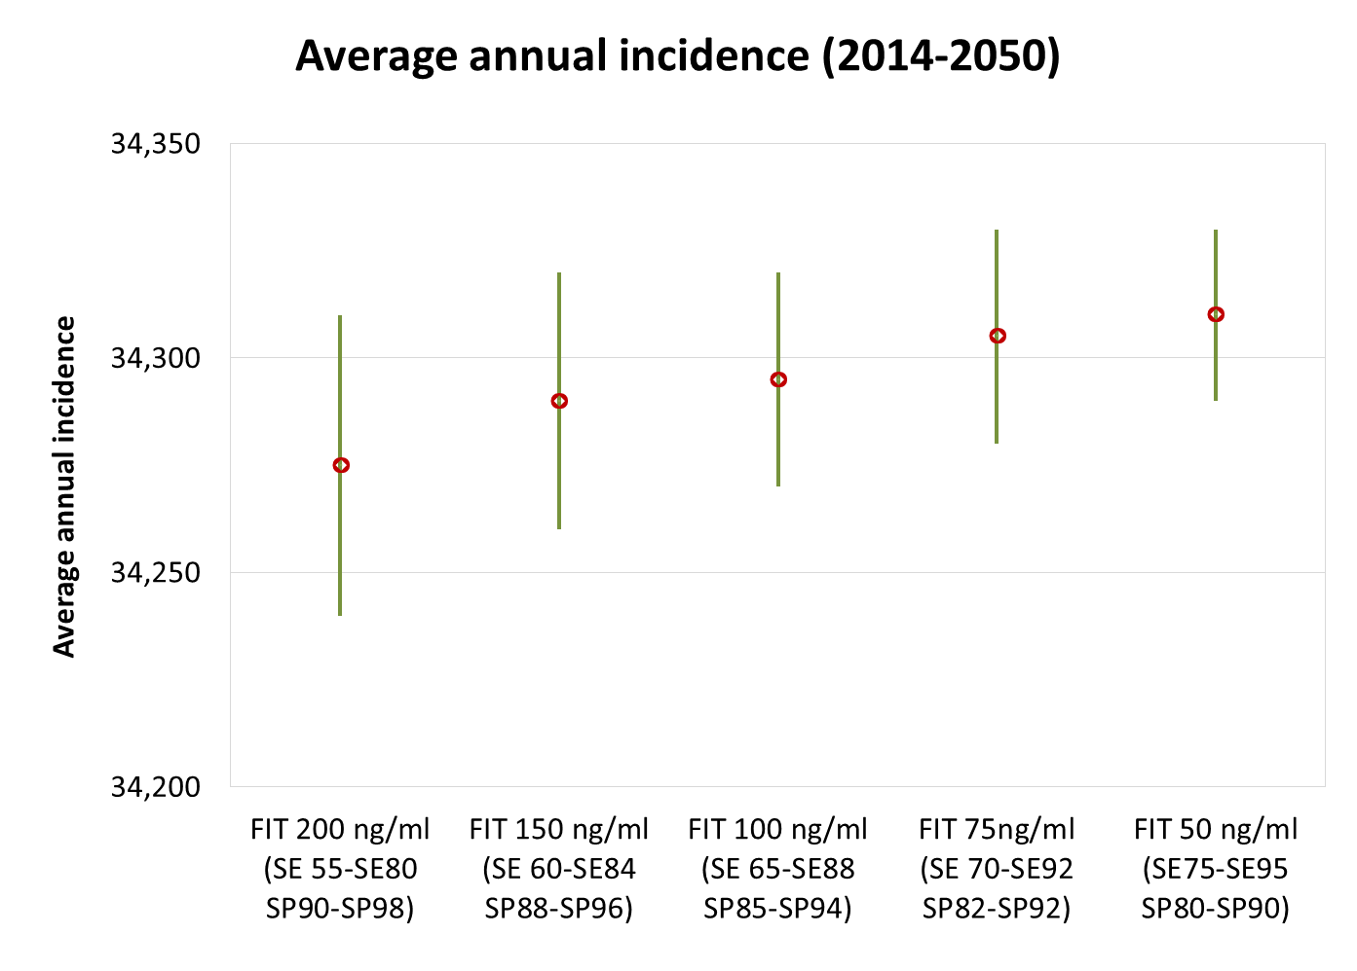
Notes:
0.1% difference

Slide 29
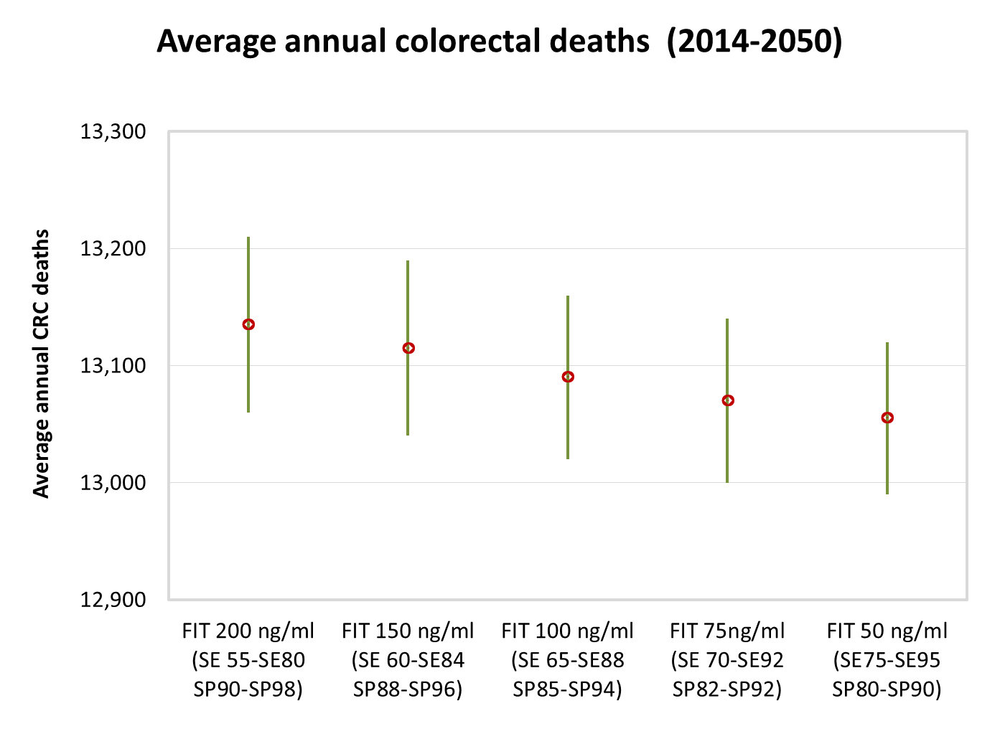
Notes:
0.6% difference

Slide 30
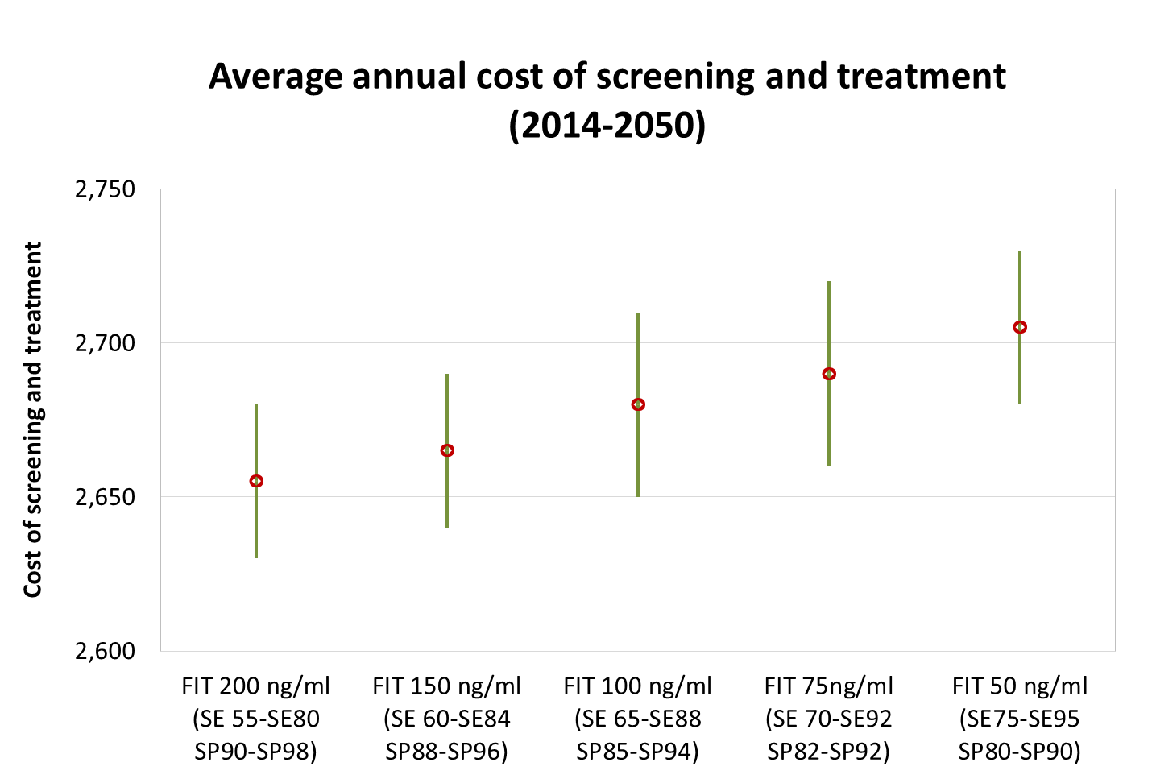
Billions
Notes:
2% increase in avg annual cost

Slide 31
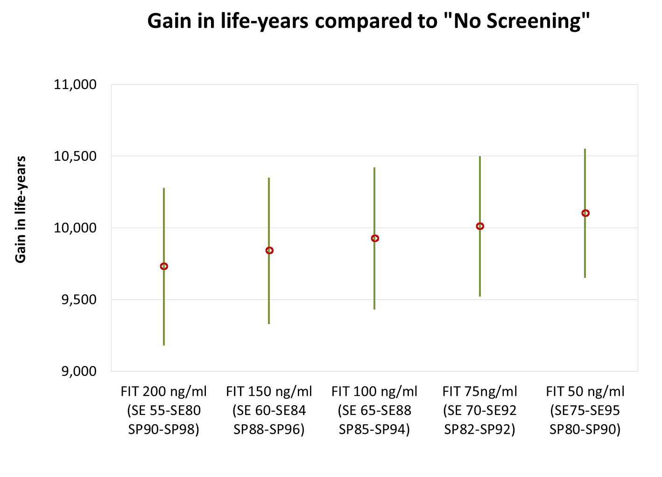
Notes:
4% increase in LYs

Slide 32
Notes:
80% increase in the number of colonoscopies performed per year

Slide 33
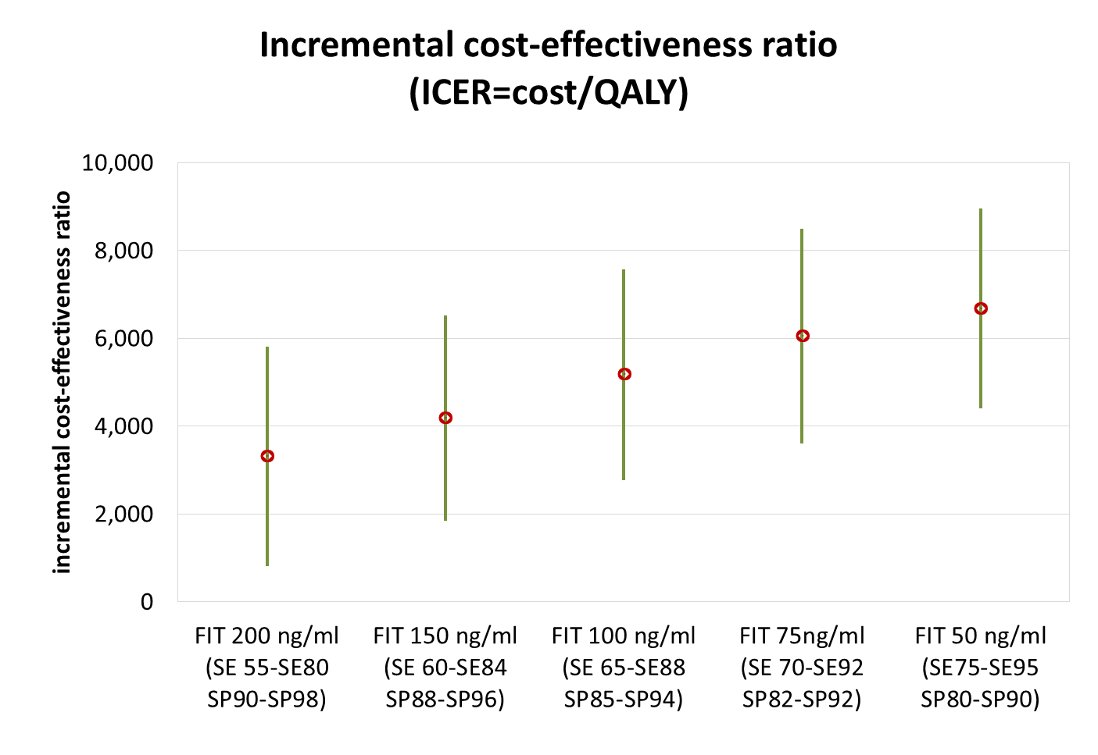
Notes:
100% increase in ICER - doubles

Slide 34
Conclusions
Colonoscopy most cost-effective, gFOBT least
FIT reasonably cost-effective, especially when high-risk patients are directed to colonoscopy
FIT cut-offs have small impact on health outcomes or total overall cost, but significant implications on # colonoscopies

Slide 35
Limitations
Basecase scenario assumes no screening, but we know some opportunistic screening occurred in some provinces
Programmatic screening needs to be incorporated into basecase
Overhead costs of increasing colonoscopy capacity not incorporated

Slide 36
Additional work
Continue exploring FIT cut-off thresholds
Explore impact of # samples collected
Report to be disseminated with jurisdictional results

Slide 37
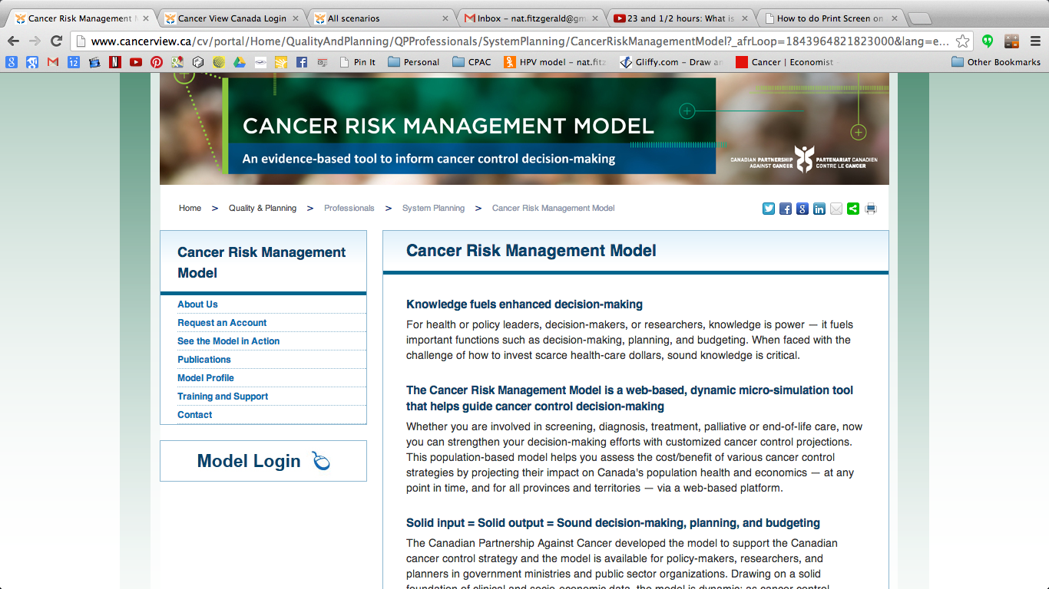
https://cancerview.ca/cancerriskmanagement
Natalie Fitzgerald, Program Manager, Economics, CRM
natalie.fitzgerald@partnershipagainstcancer.ca
416-619-5780

Slide 38
APPENDIX

Slide 39
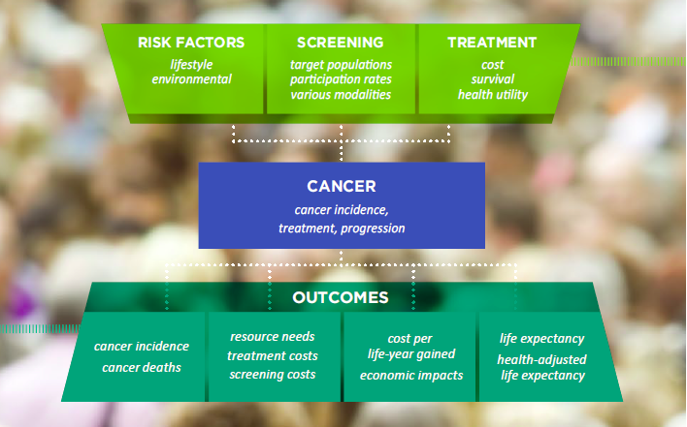
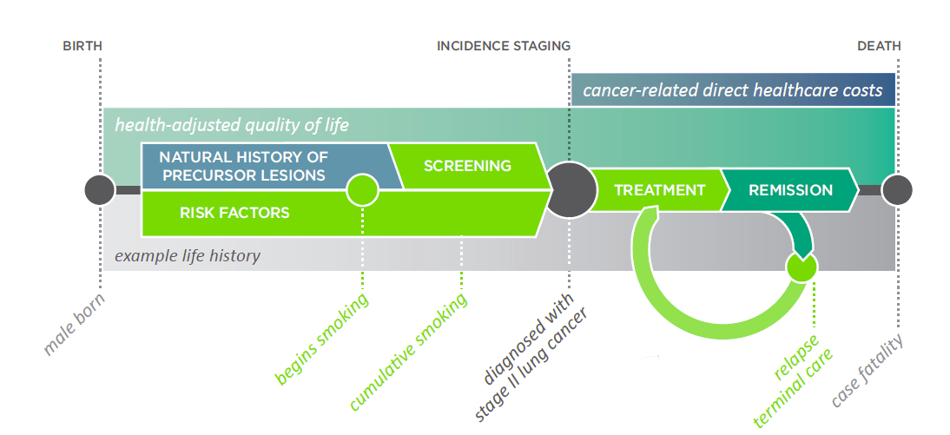
What is the Cancer Risk Management Model (CRMM)?
Colorectal cancer
  Screening, prevention, treatment
Lung cancer
  Smoking, radon, screening, treatment
HPV transmission
  Vaccination
Cervical cancer
  Screening, treatment
Breast cancer
  Screening, treatment
health-related quality of life
Notes:
CRMM is a microsimulation model, developed by a team at Statistics Canada, as well as a host of other modelling experts, health economists and clinicians.
The CRMM includes CRC, lung, HPV and cervical models, and we are currently developing a breast model.
The cervical model was adapted from the Brisson model, which uses thousands of parameters which are assigned values using empirical data where available, published literature, and expert opinion.
The model inputs, such as risk factors, screening programs and treatment patterns are overlaid onto the demographics of the Canadian population.
The outputs can be drilled down to jurisdiction, age, sex, or as detailed as disease stage. We can pull out direct healthcare costs, health outcomes, quality-of-life adjustments, as well as economic indicators.
The model is extremely flexible and can answer a multitude of policy questions. We are constantly assessing the model’s performance, and incorporating new data as it becomes available, to ensure we can address the most recent issues.
Many of you may be in the position of having to make tough decisions regarding screening programs in the future, while balancing the benefits and harms of screening in vaccinated cohorts, so we’re hopeful that the model and its outputs can serve as a resource to you.

Slide 40
Natural history diagram
Normal
Preclinical CRC
Stage 1 (TMN)
Clinical CRC
Stage 1 (TMN)
Neoplastic polyps (≤5 mm)
Preclinical CRC
Stage 2 (TMN)
Clinical CRC
Stage 2 (TMN)
Non-resectable distant or local recurrence
Neoplastic polyps (6-9 mm)
Preclinical CRC
Stage 3 (TMN)
Clinical CRC
Stage 3 (TMN)
Death
Cure
Neoplastic polyps (≥10 mm)
Preclinical CRC
Stage 4 (TMN)
Clinical CRC
Stage 4 (TMN)

Slide 41
Publications
William K. Evans, Michael C. Wolfson, William M. Flanagan, Janey Shin, John Goffin, Anthony B. Miller, Keiko Asakawa, Craig Earle, Nicole Mittmann, Lee Fairclough, Jillian Oderkirk, Philippe Finès, Stephen Gribble, Jeffrey Hoch, Chantal Hicks, D. Walter R. Omariba and Edward Ng (2013). Canadian Cancer Risk Management Model: evaluation of cancer control. International Journal of Technology Assessment in Health Care, 29, pp 131-139.
William K. Evans, Michael Wolfson, William M. Flanagan, Janey Shin, John R. Goffin, Keiko Asakawa, Craig Earle, Nicole Mittmann, Lee Fairclough, Philippe Finès, Steve Gribble, Jeffrey Hoch, Chantal Hicks, Walter D.R. Omariba & Edward Ng (2012). The evaluation of cancer control interventions in lung cancer using the Canadian Cancer Risk Management Model. Lung Cancer Management, 1:1 pp 25-33.

Slide 42
Colorectal cancer mortality per 100,000
 | 2015 |  | 2030 |  | 2050
 | Males | Females | Males | Females | Males | Females
Biennial gFOBT | 29.5 | 25.4 | 38.0 | 30.5 | 47.1 | 33.6
Biennial FIT | 29.7 | 25.4 | 31.2 | 29.3 | 37.2 | 32.5
FIT 30% and 30% Colonoscopy | 29.8 | 25.6 | 28.7 | 20.1 | 35.0 | 20.9
FIT 48% and 12% Colonoscopy | 27.0 | 25.4 | 29.0 | 26.7 | 34.4 | 28.2
*60% participation; non-age standardized; gFOBT; guaiac Fecal Occult Blood Test; FIT: fecal immunochemical test:
Col: Colonoscopy; CRC: Colorectal cancer

Slide 43
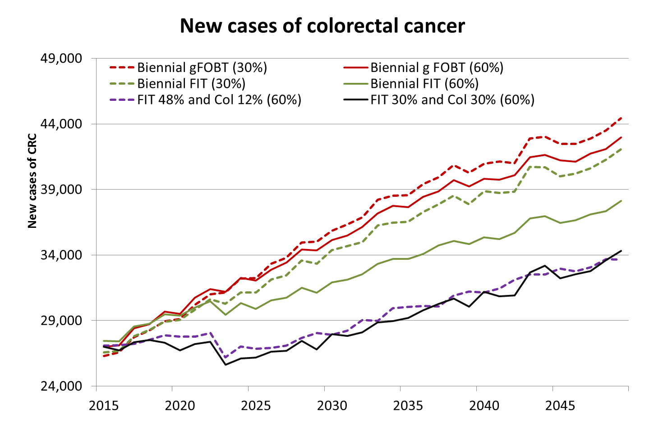
*participation rates (%) ; non-age standardized; gFOBT; guaiac Fecal Occult Blood Test; FIT: fecal immunochemical test:
Col: Colonoscopy; CRC: Colorectal cancer

Slide 44
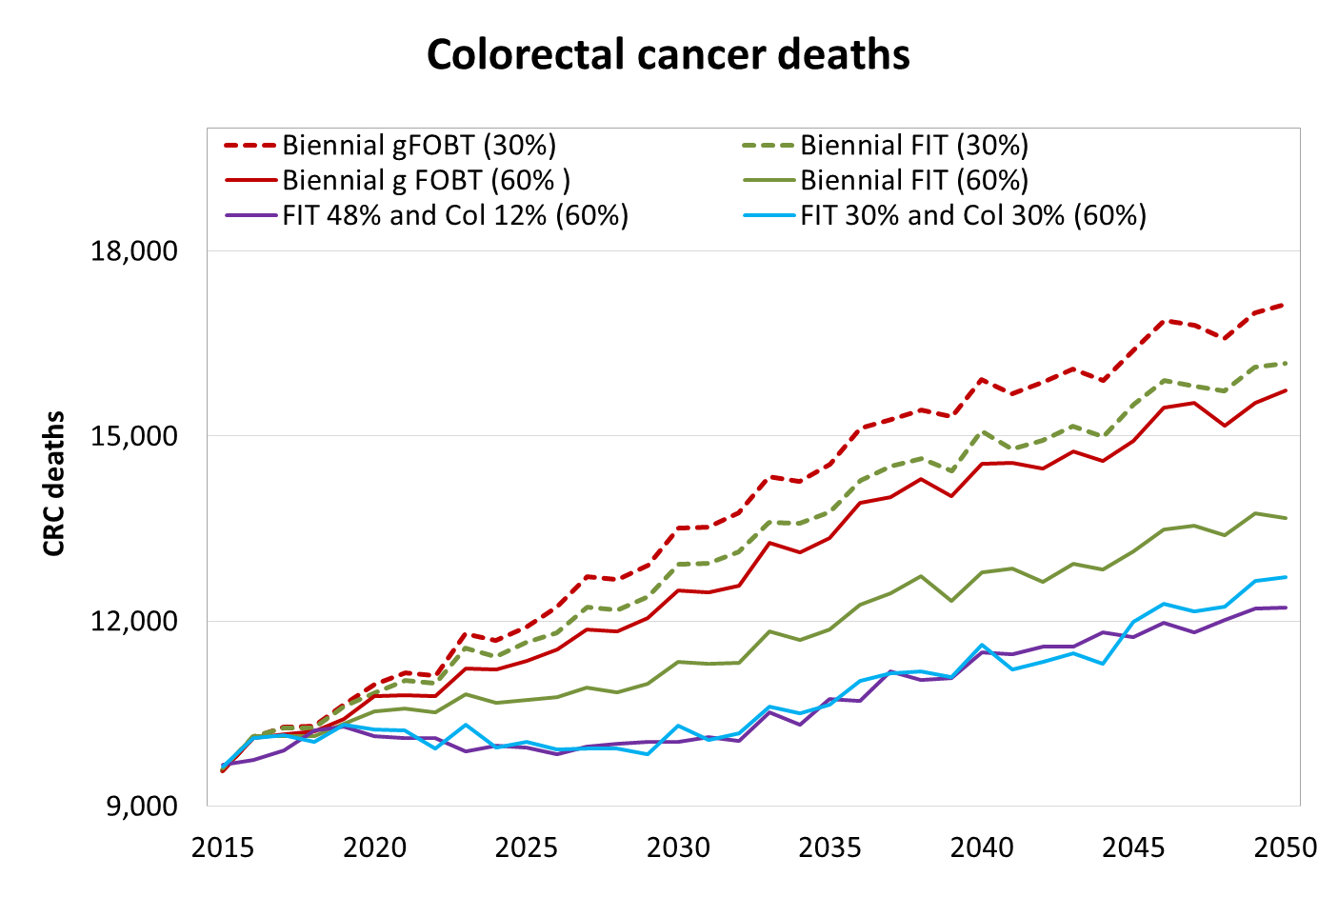
*participation rates (%) ; non-age standardized; gFOBT; guaiac Fecal Occult Blood Test; FIT: fecal immunochemical test:
Col: Colonoscopy; CRC: Colorectal cancer

Slide 45
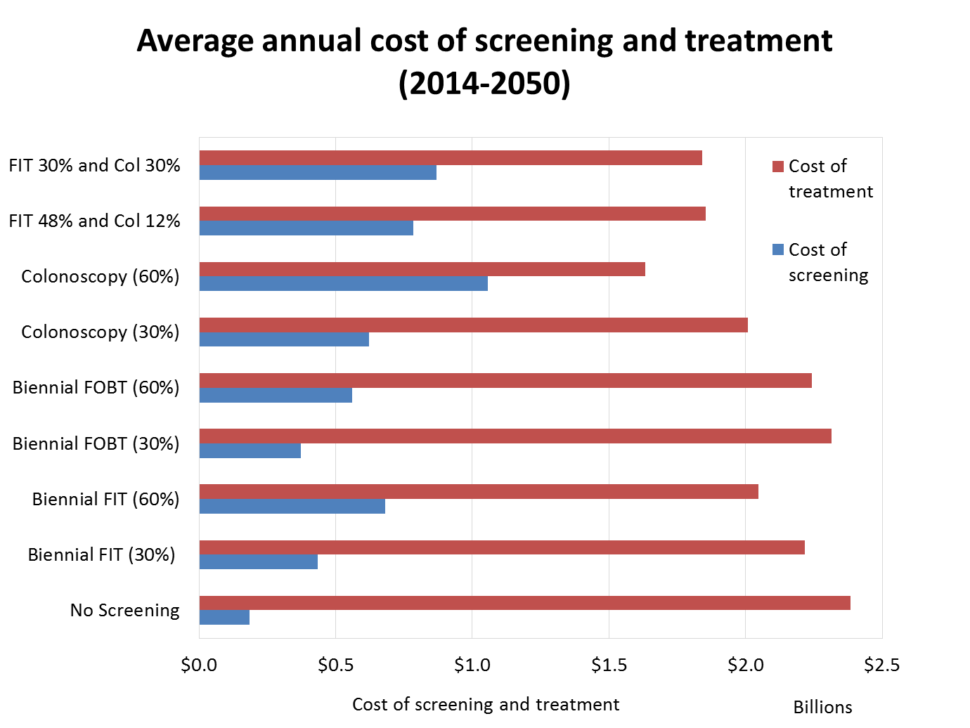

Slide 47

Who is Leading the CRM?
Input from various sources: Advisory groups,
Screening Networks, Partnership Council, etc.
CRM Steering Committee
CRM
Program
Anthony Miller (Chair), Lee Fairclough, Heather Bryant, Andy Coldman, Jon Kerner,
Bill Evans, Michael Wolfson, Cathy Popadiuk, Andrea Reed
Team
Model
Programming
Lead Development Groups
Cancer
Groups
Economics
(Natalie
Fitzgerald,
Modelling
CRC Team
HPV/Cervical
Breast Cancer
ARCC*
Gina
capacity
Lung Cancer
Lead
Cancer Team
Team Lead
Dr. Jeffrey
Stats Can
Dr. Michael
Team Lead
Dr. Andy
Lead
Dr. Anthony
Hoch
Lockwood,
Saima Memon
Wolfson
Dr. Bill Evans
Coldman
Dr. Cathy
Miller
Dr. Stuart
Popadiuk
Peacock
Sharon Fung)
Lung
CRC working
HPV/cervical
Breast
working
group
working
working
group
group
group
*Canadian Centre for Applied Research in Cancer Control
Notes:
Project began in January 2007 with a team from Statistics Canada and cancer leaders in Canada responsible for developing the core platform.
We receive input and direction from a variety of sources, such as advisory groups, the Screening Networks, and provincial cancer agencies that sit around the table that we call the Partnership Council
The Steering Committee is comprised of expert leads from across Canada, as well as some key CPAC staff. The expert team leads are experts in their respective fields, and head the working groups that are made up of other clinical leads, statisticians, biostatisticians, modelling experts, health economists and researchers.
We are also fortunate to have a very capable statistical and modelling team through Bill and his team at Statistics Canada, and health economics expertise.
So now that we have a model developed, how do we get people to use the model and its outputs?
External model validation:
Technical and clinical
Case study evaluations
Collaboration with CISNET and other modelers to compare methodology and results
CPAC will actively engage and work with the cancer control partners for input (ensure policy relevance), uptake and knowledge translation efforts

Slide 48
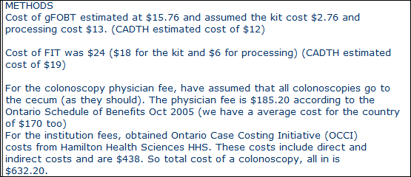
Screening costs

Slide 49
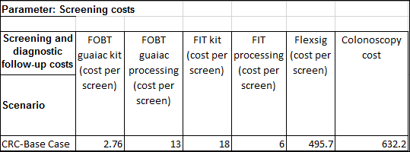
Screening costs

Slide 50
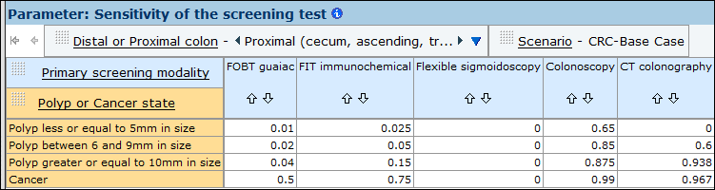
Sensitivity of the screening test (proximal colon)

Slide 51
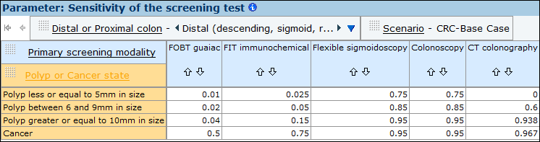
Sensitivity of the screening test (distal colon)

Slide 52
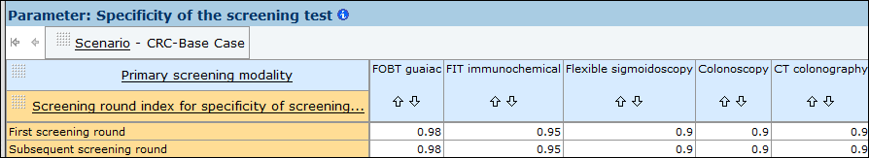
Specificity of the screening test

