Slide 1
LUNG CANCER SCREENING & SMOKING CESSATION

Slide 2
Acknowledgements

Slide 3
Objectives

Slide 5
Is it cost-effective?

Slide 6
Cost-Effectiveness Ratios

Slide 7
How do the CRMM results compare to other results?

Slide 8
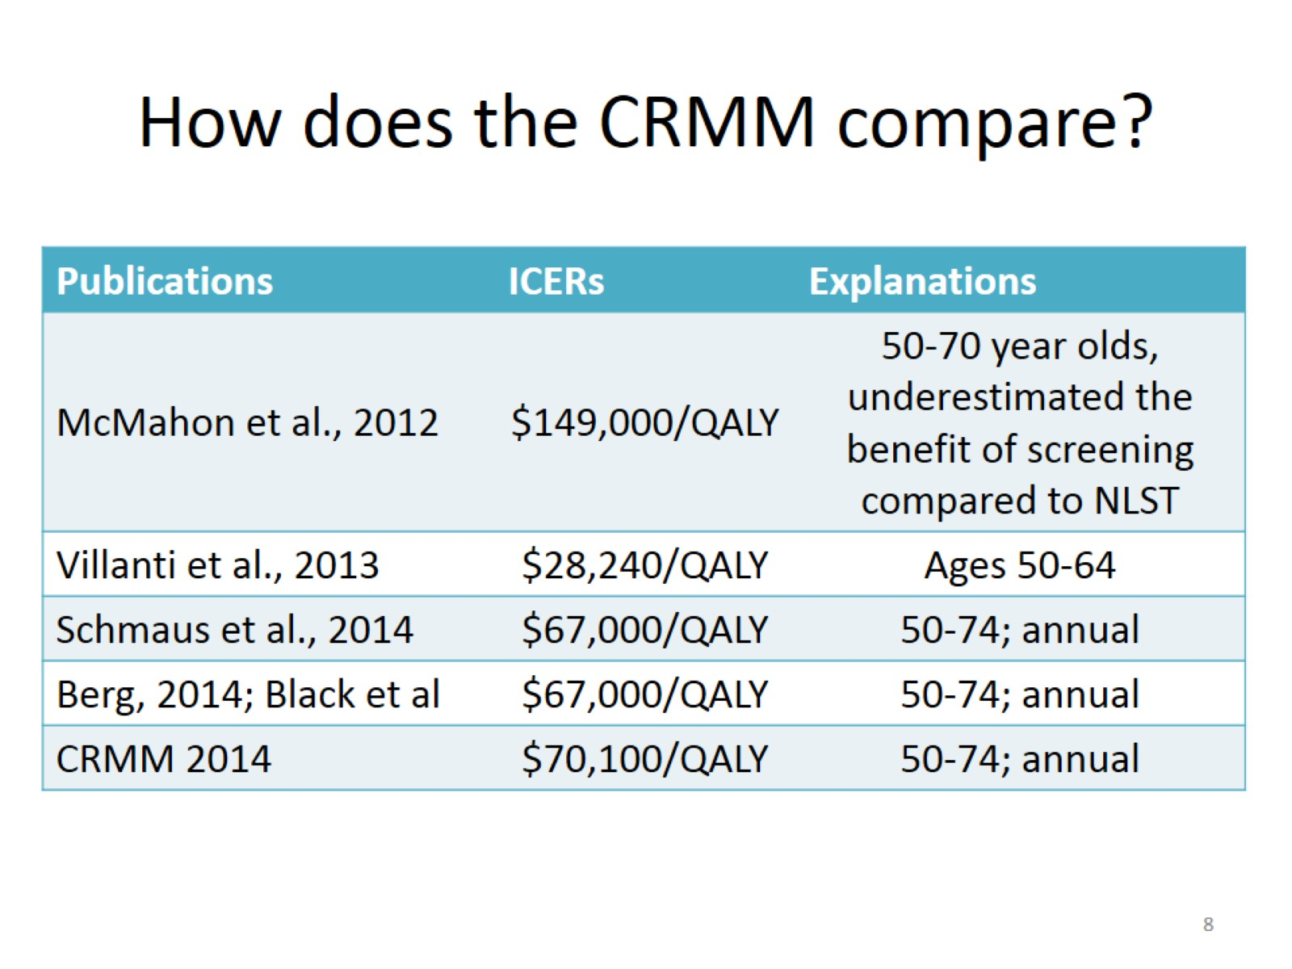
How does the CRMM compare?

Slide 9
What does this mean for you?

Slide 10
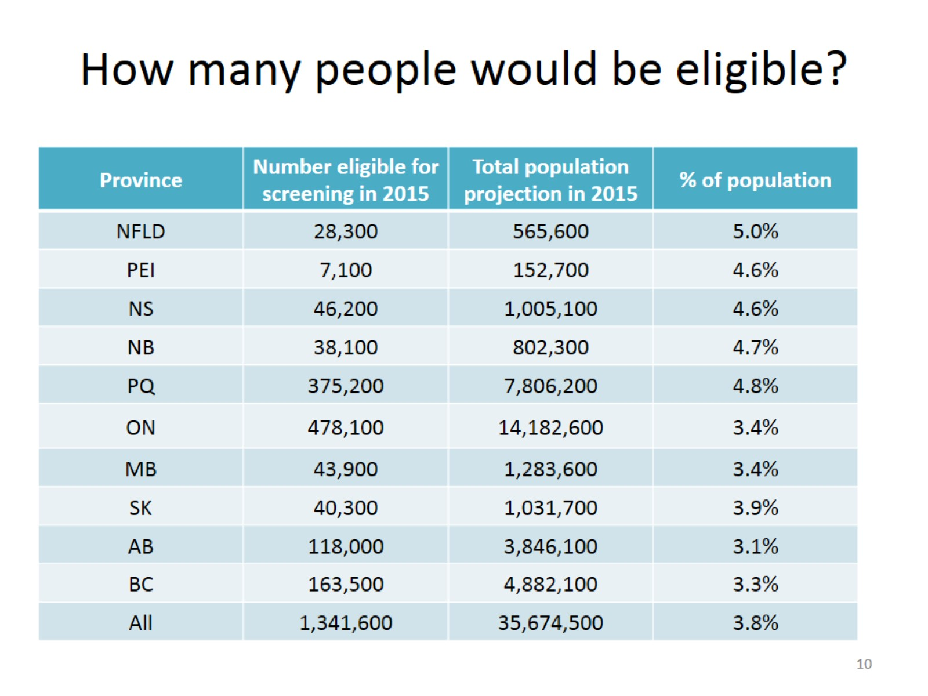
How many people would be eligible?

Slide 11
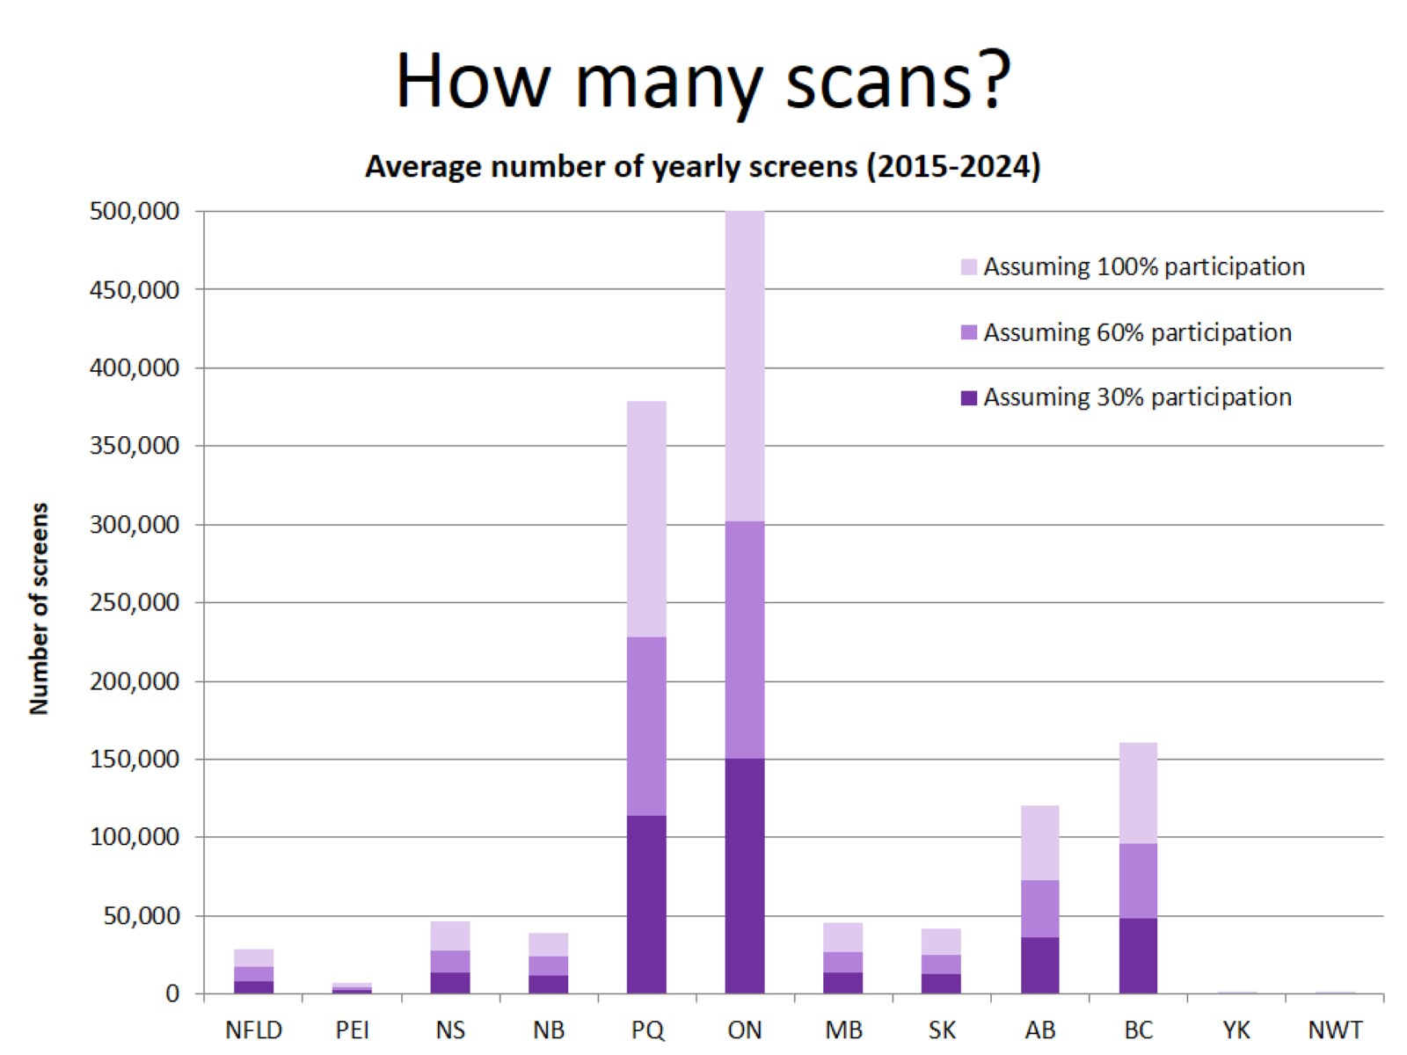

Slide 12
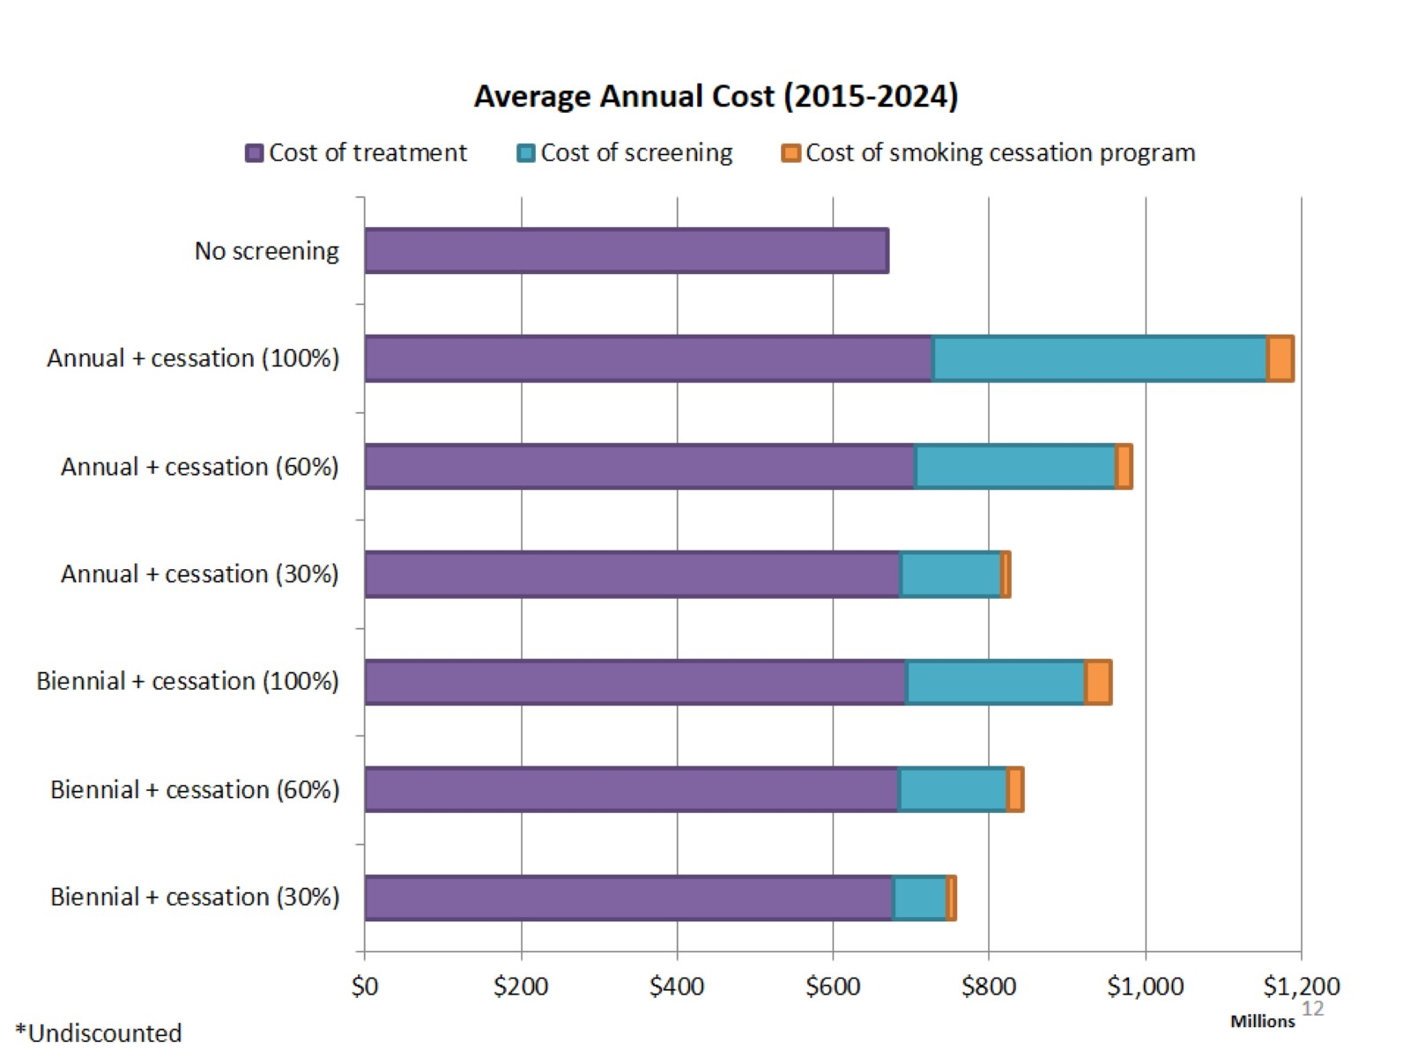

Slide 13
What if the smoking cessation program was super expensive?

Slide 14
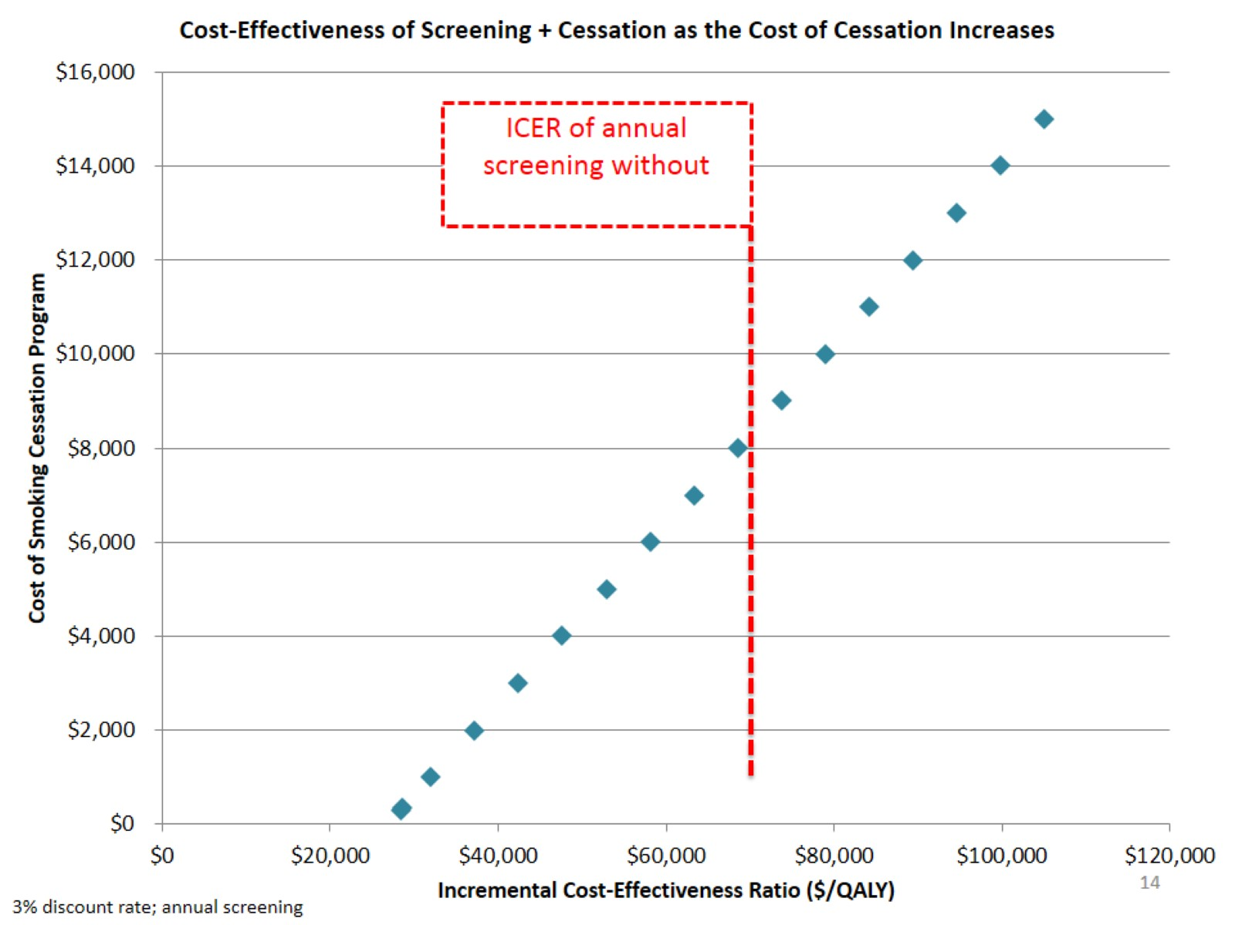

Slide 15
Conclusions

Slide 16
Limitations

Slide 17
Additional work

Slide 19
APPENDIX

Slide 20
What is the Cancer Risk Management Model (CRMM)?

Slide 21
Who is Leading the CRM?

Slide 22
Publications

Slide 23
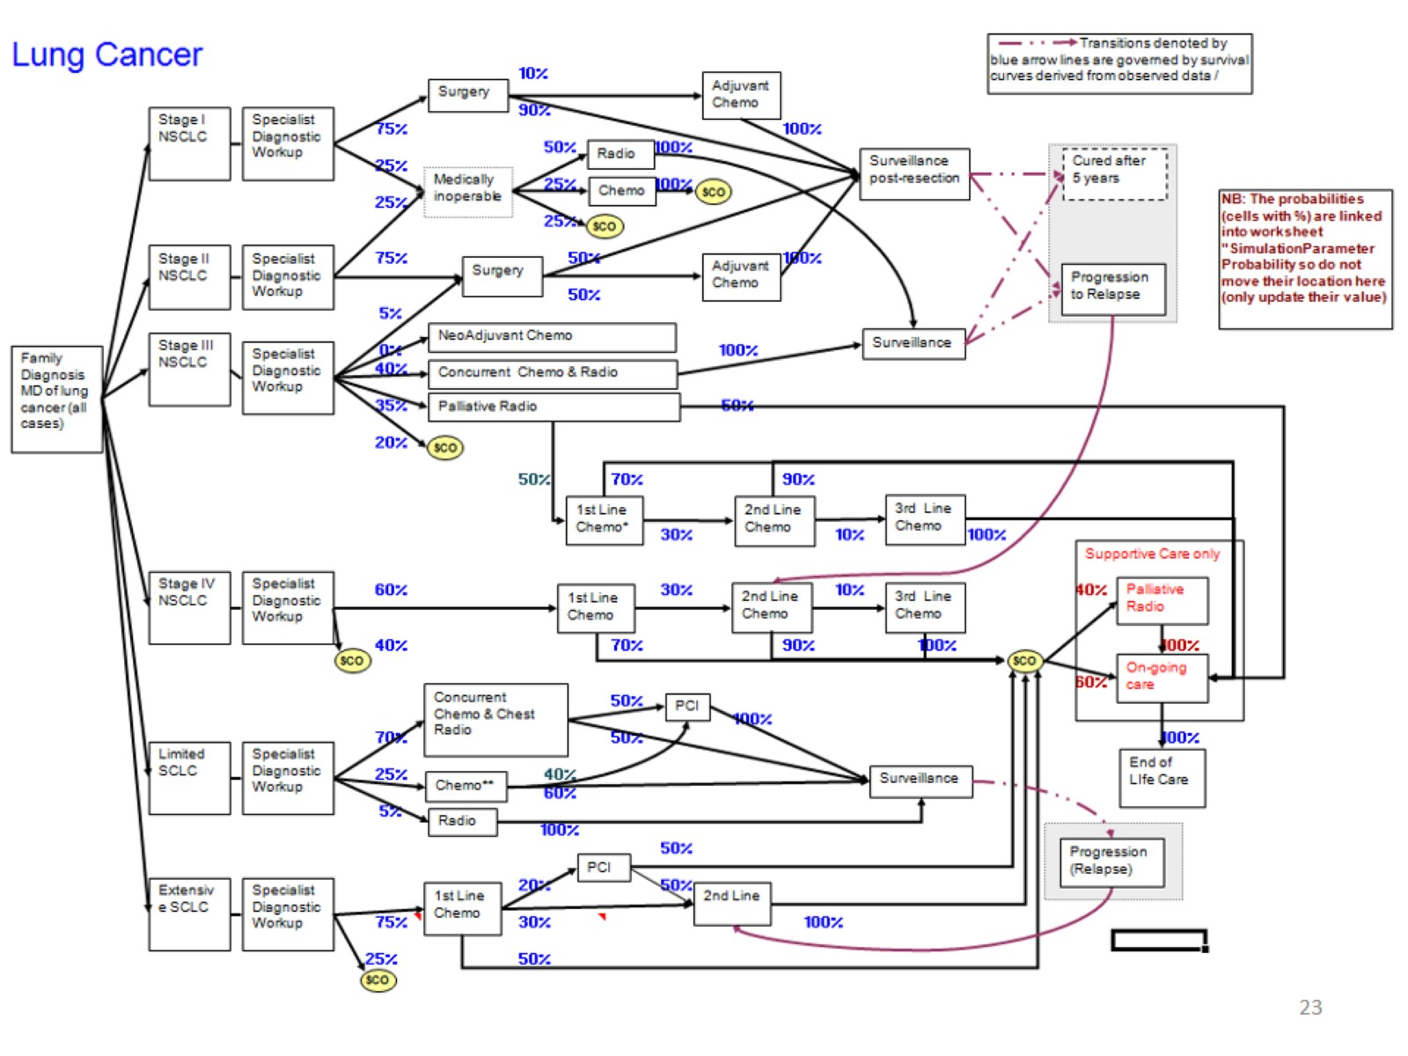

Slide 24
Changes since the last presentation to the Network:

Slide 25
Number of new lung cancer cases by trial arm by year of study from Model and NLST

Slide 26
Lung Cancer Mortality Reduction

Slide 27
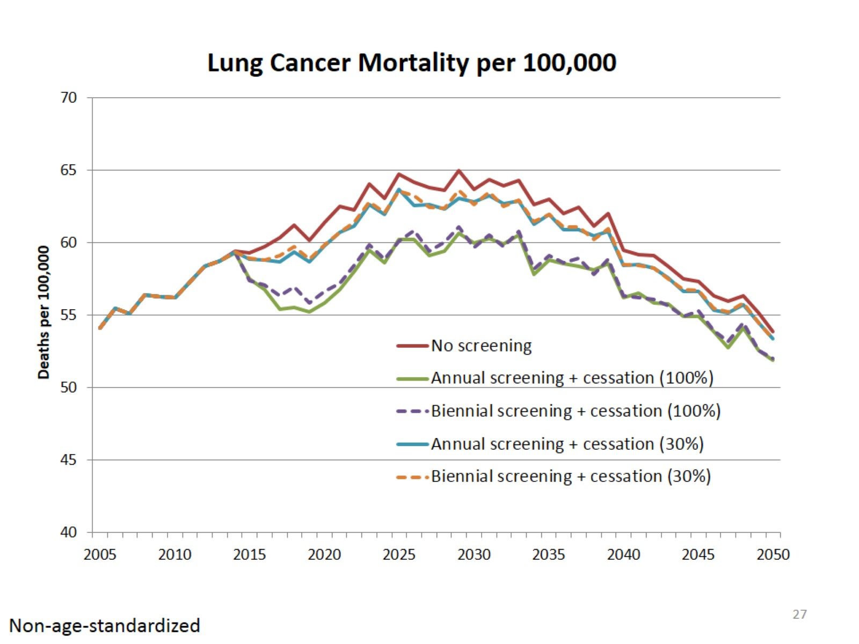

Slide 28
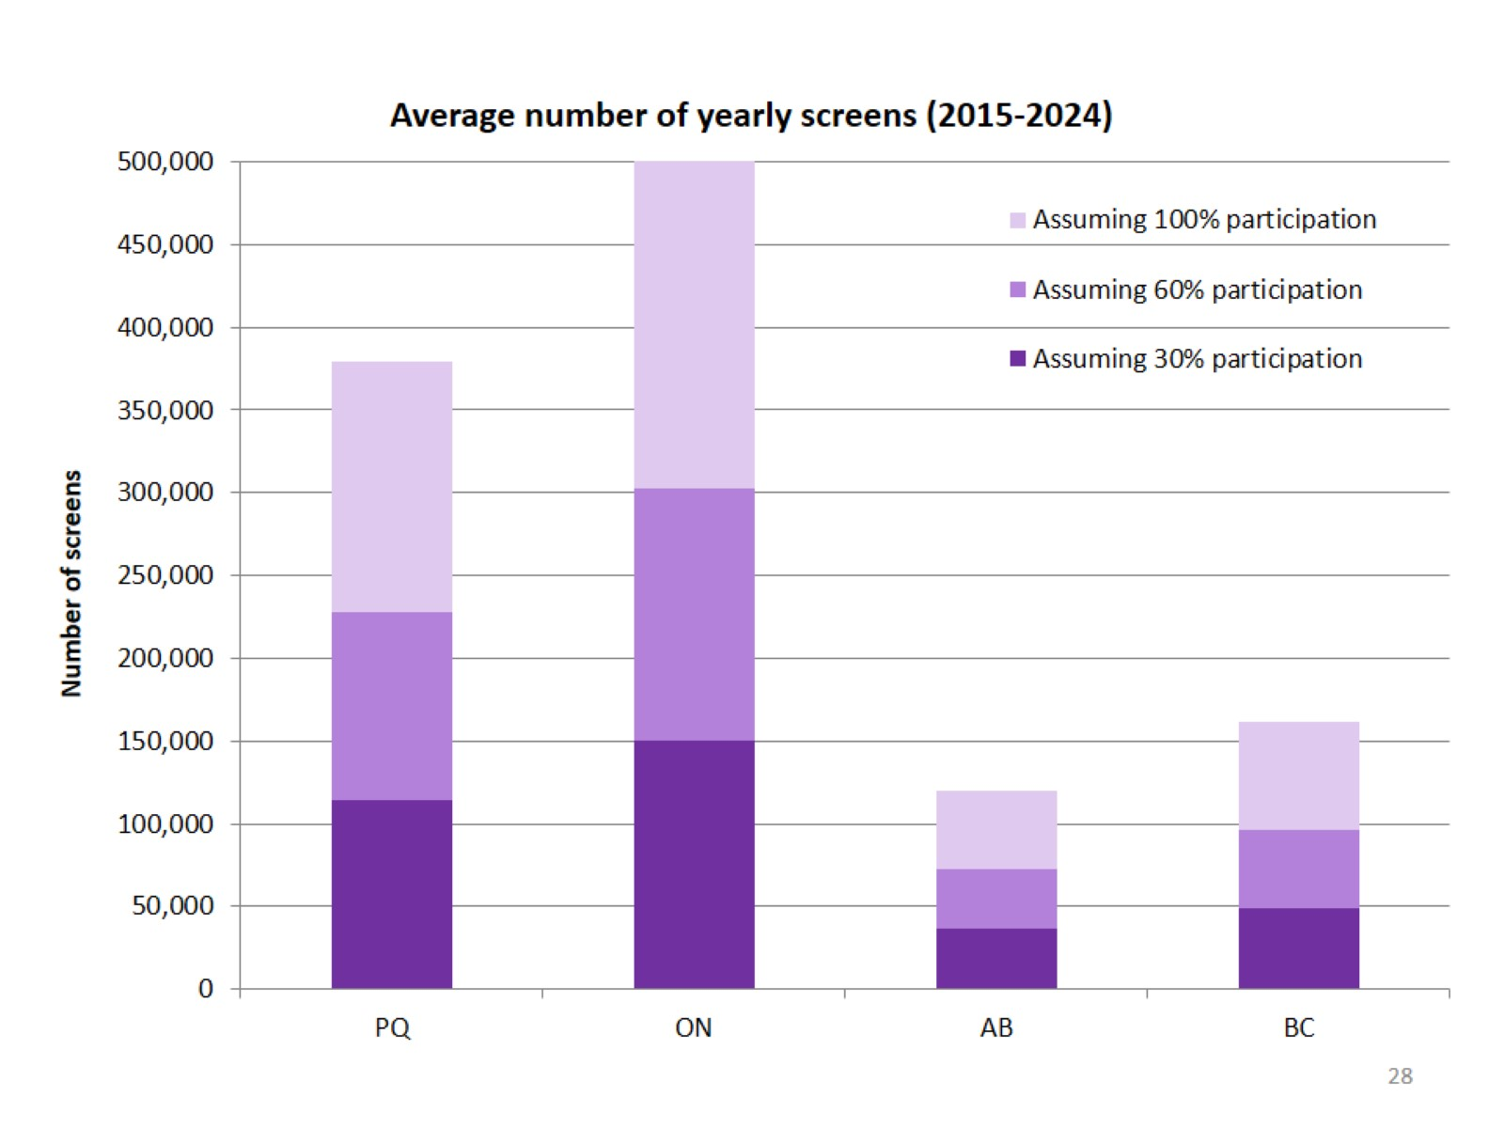

Slide 29
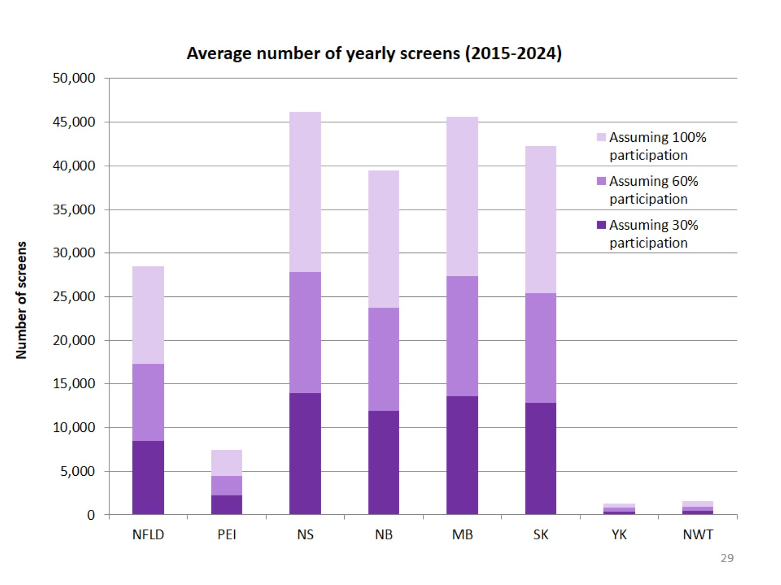

Slide 30
Insert jurisdictional cost slides

Slide 31
Over-diagnosis

Slide 32
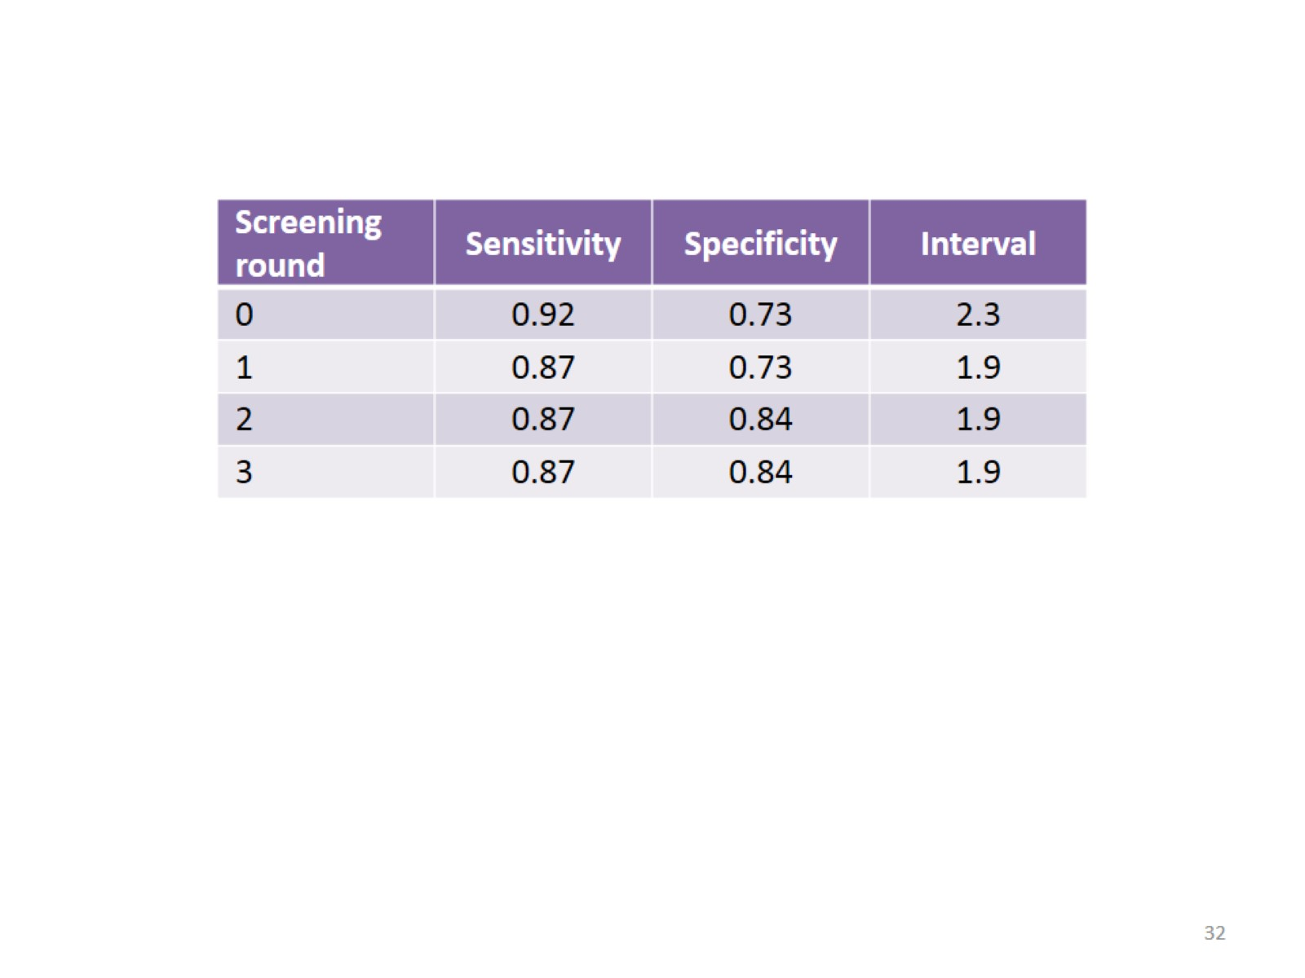

Slide 33
