Slide 1


Harmonizing radiotherapy
Quality and safety in Canada
Narrated by:
Erika Brown – CPQR Project Lead
administration@cpqr.ca

Slide 2
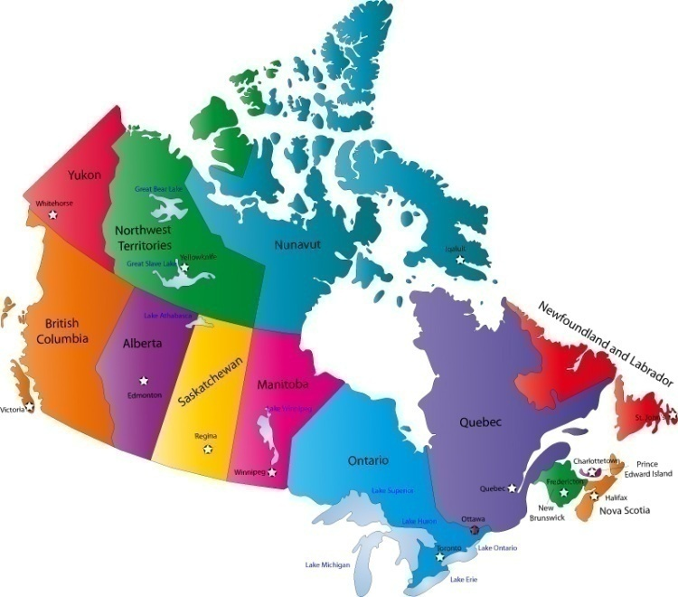

RADIOTHERAPY IN CANADA TODAY
More than 40% of cancer cases will require radiotherapy
42 radiation treatment centres in Canada
100,000 courses of radiotherapy annually
Canadian Partnership for Quality Radiotherapy
Partenariat canadien pour la qualité en radiothérapie

Slide 3
RADIOTHERAPY IS…
Increasingly effective
Increasingly complex
Demanding an increased level of assurance optimal system performance and clinical outcomes
Canadian Partnership for Quality Radiotherapy
Partenariat canadien pour la qualité en radiothérapie

Slide 4
PATIENT AWARENESS
Canadian Partnership for Quality Radiotherapy
Partenariat canadien pour la qualité en radiothérapie
Notes:
Could remove this slide and touch on this in the following slide (that depicts our organizational structure)

Slide 5
HARMONIZING
RADIOTHERAPY QUALITY IN CANADA
Local cancer programs
  Programmatic priority
  Adequate resources
  Culture of quality and safety
  Policies and procedures
Provincial and national
  Accreditation
  Guidelines, standards, indicators
  Clinical trials
  Incident reporting and learning
Canadian Partnership for Quality Radiotherapy
Partenariat canadien pour la qualité en radiothérapie

Slide 6
CANADIAN PARTNERSHIP FOR
QUALITY IN RADIOTHERAPY (CPQR)
Canadian Partnership for Quality Radiotherapy
Partenariat canadien pour la qualité en radiothérapie
Notes:
Could remove this slide and touch on this in the following slide (that depicts our organizational structure)

Slide 7
CPQR PRIORITIES
Five year funding secured from CPAC
High impact
      Build systems and capacity
      Harmonize quality and safety practices
      Consultation, validation and adoption
Collaborations and partnerships
  Canadian Association Provincial Cancer Agencies, Accreditation Canada, Canadian Institute for Health Information and Canadian Nuclear Safety Commission
Sustainable beyond 5 years
Canadian Partnership for Quality Radiotherapy
Partenariat canadien pour la qualité en radiothérapie
Notes:
Steering Committee nationally representative.
Responsible for setting work agenda and developing processes to ensure appropriate national input is included in their implementation/achievement
Advisory Group currently has over 50 members.
Receives quarterly updates of Partnership progress
Provides input on draft documents and plans
Helps increase awareness of importance of CPQR activities

Slide 8
CPQR INITIATIVES
Initiative | Deliverable
Programmatic Performance “making sure the program and processes work” | Quality Assurance Guidance for Canadian Radiation Treatment Guidelines, a National Accreditation Module for radiation treatment and quality indicators for site specific radiation treatment
Equipment Performance “making sure the equipment and software work” | Technical Quality Control Guidelines
Incident Learning “learning from our mistakes” | Support development of a National System for Incident Reporting – Radiation Therapy (NSIR-RT) with the Canadian Institute for Health Information (CIHI)
Patient Perspective “add a patient voice to the radiation treatment quality and safety dialogue”
Canadian Partnership for Quality Radiotherapy
Partenariat canadien pour la qualité en radiothérapie

Slide 9
CPQR OPERATIONAL MODEL
Canadian Partnership for Quality Radiotherapy
Partenariat canadien pour la qualité en radiothérapie

Slide 10

QUALITY ASSURANCE GUIDANCE FOR CANADIAN RADIATION PROGRAMS
Harmonized QA framework for radiation treatment programs across Canada
Key quality indicators for monitoring programmatic performance
Published online in 2011 with V2.0 released in Sept 2013 following broad community consultation
CPQR and CPAC are partnering with Accreditation Canada on the development of a Qmentum module on radiation treatment
www.cpqr.ca and www.pcqr.ca
Canadian Partnership for Quality Radiotherapy
Partenariat canadien pour la qualité en radiothérapie

Slide 11
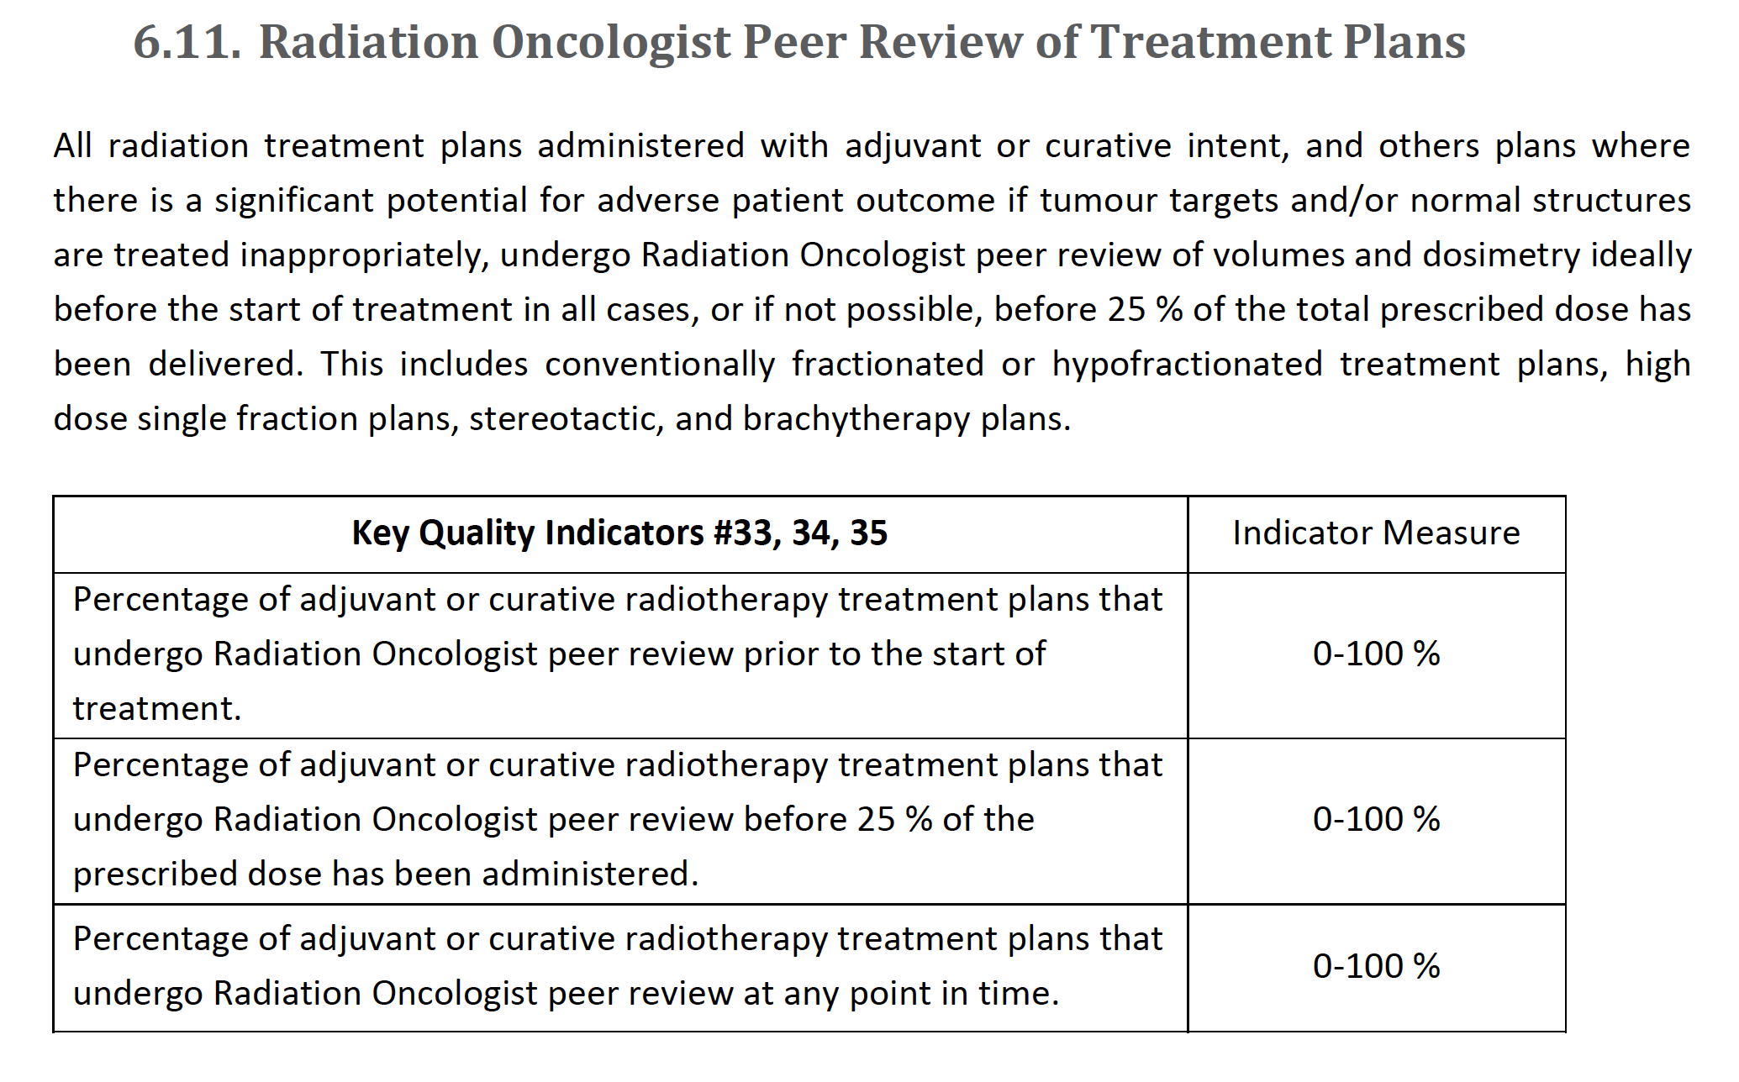
PEER REVIEW
Canadian Partnership for Quality Radiotherapy
Partenariat canadien pour la qualité en radiothérapie

Slide 12

Quality Indicators for Radiation treatment
Develop quality of care indicators guiding the use of radiotherapy (external and brachytherapy) for complex cancer sites including cervix, breast, and prostate
Incorporate these indicators into a national monitoring program
Canadian Partnership for Quality Radiotherapy
Partenariat canadien pour la qualité en radiothérapie

Slide 13
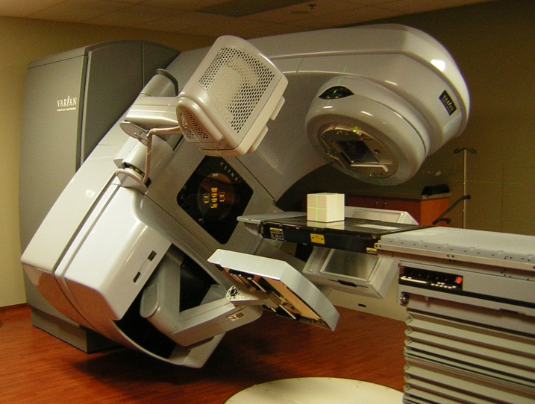
TECHNICAL QUALITY CONTROL
Assure predictable, reproducible performance of hardware and software
Guidance for acceptance testing, commissioning, periodic quality control testing
Indicators of compliance and performance
Comprehensive, relevant, adaptable
Guidelines for hardware and software technologies
Canadian Partnership for Quality Radiotherapy
Partenariat canadien pour la qualité en radiothérapie

Slide 14
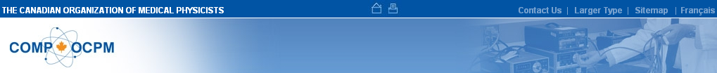
TECHNICAL QUALITY CONTROL
Accelerator-Integrated Cone-Beam Systems for Verification Imaging
Brachytherapy Remote Afterloaders
Conventional Radiotherapy Simulators
Medical Linear Accelerators and Multileaf Collimators
Treatment Planning Systems
Kilovoltage X-ray Radiotherapy
Major Dosimetry Equipment
Low Dose Rate Permanent Seed Brachytherapy
Computed Tomography Simulators
www.cpqr.ca or www.medphys.ca
Canadian Partnership for Quality Radiotherapy
Partenariat canadien pour la qualité en radiothérapie

Slide 15
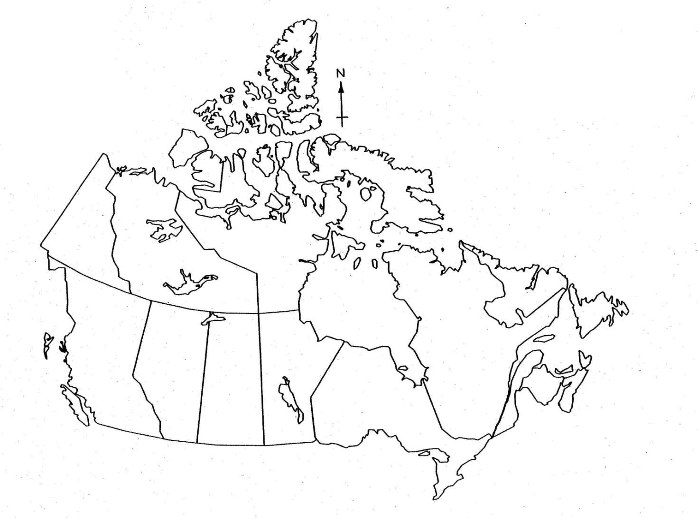
TECHNICAL QUALITY CONTROL
Pan-Canadian Engagement
Steering Committee Members
QARSAC Committee Members
Expert Reviewers
External Validation Centres
Canadian Partnership for Quality Radiotherapy
Partenariat canadien pour la qualité en radiothérapie

Slide 16
NATIONAL INCIDENT LEARNING
Benefits
  Learn from our mistakes
  Prevent incident propagation
  Drive technology and process improvements
  Why now?
  Public demand
  Increasing interest by regulators
  Window of opportunity to self-monitor
Canadian Partnership for Quality Radiotherapy
Partenariat canadien pour la qualité en radiothérapie

Slide 17
NATIONAL INCIDENT LEARNING
Challenges
Scope
Severity classification
Taxonomy
Privacy and confidentiality
Compatible with other reporting systems
Data ownership and access
Culture of trust and disclosure
Canadian Partnership for Quality Radiotherapy
Partenariat canadien pour la qualité en radiothérapie

Slide 18
PATIENT PERSPECTIVE
Integrating the patient perspective into CPQR initiatives through patient representation at all CPQR committee levels
Addressing expectations related to patient experience and satisfaction through the development of indicators related to quality of care
Canadian Partnership for Quality Radiotherapy
Partenariat canadien pour la qualité en radiothérapie

Slide 19
CPQR UPTAKE
CPQR ‘Quality Assurance Guidance for Canadian Radiation Treatment Programs’ downloaded >2000 times in 6 months
New CPQR Technical Quality Control Guidelines >1000 website ‘hits’ in 2 weeks
Changes to policies and procedures in >50% of programs across Canada
Canadian Partnership for Quality Radiotherapy
Partenariat canadien pour la qualité en radiothérapie
Notes:
QA guidance document download statistics during the first 6 months (April - September 2011):
2059 English downloads from Cancerview.ca and PartnershipAgainstCancer.ca
495 French language abstract downloads that lead to full English downloads from Cancerview.ca and PartnershipAgainstCancer.ca
Ranks among the top document downloads of all time from Cancerview.ca and PartnershipAgainstCancer.ca
4 workshops at national and provincial conferences plus 1 scheduled for the fall at CARO/COMP: Towards Canadian Consensus on Key Quality Indicators for Radiation Treatment Programs Using a Modified Delphi Process
18 presentations and talks at national and international meetings including 2 coming up at Tom Baker and the Atlantic Oncology Group. Recently posters were presented at the ASCO Quality Care Symposium and an invited talk is being prepared for the CARO-ESTRO Symposium at CARO/COMP ASM
3 Papers directly discussing CPQR QA Indicators and potential impacts of this work including the ASTRONews article
QA Guidance document referenced
COMP Winter School 2012 - 11 presentations referenced CPQR TQC or QA Guidance work
COMP Winter School 2013 - 13 presentations referenced CPQR TQC or QA Guidance work
Advisory Group poll:
20/22 centres report having accessed the document
67% of those have made changes to their policies and procedures as a result of the indicators contained within

Slide 20
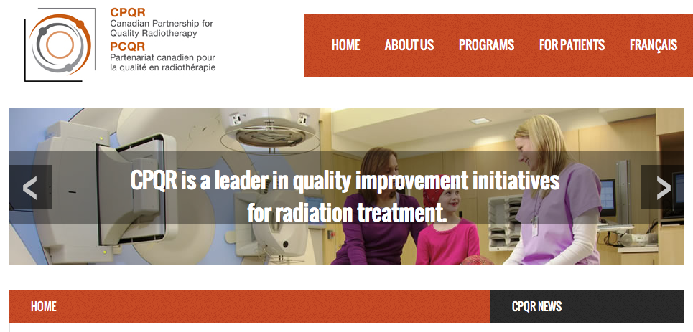
CPQR ON THE WEB
www.cpqr.ca or www.pcqr.ca
Canadian Partnership for Quality Radiotherapy
Partenariat canadien pour la qualité en radiothérapie

